Slide 1
CLAMP-ON
DESK CADDY
PDR CLASS · 3D PRINTING PITCH
A 4-in-1 organizer for pens, a mug, a phone and headphones, designed and printed by us.
Notes:
Open with the problem: student desks are small and cluttered. Say we will design and print one clamp-on caddy that holds everything. Mention you will cover design, material, print settings, plan and risks in 12 slides. Fill in team names and date.

Slide 2
STUDENT DESKS RUN OUT OF ROOM
01 · THE PROBLEM
Clutter
Spills
No fit
Pens, a phone and a mug all compete for the same desk surface.
A drink next to a laptop or notebooks is one bump away from damage.
Ready-made holders are one fixed size and can’t be adapted to our desks.
Desk Caddy · PDR pitch
2 / 12
Notes:
Keep this short. Three everyday problems everyone in the room recognises. Lead into: what if the desk edge itself became storage?

Slide 3
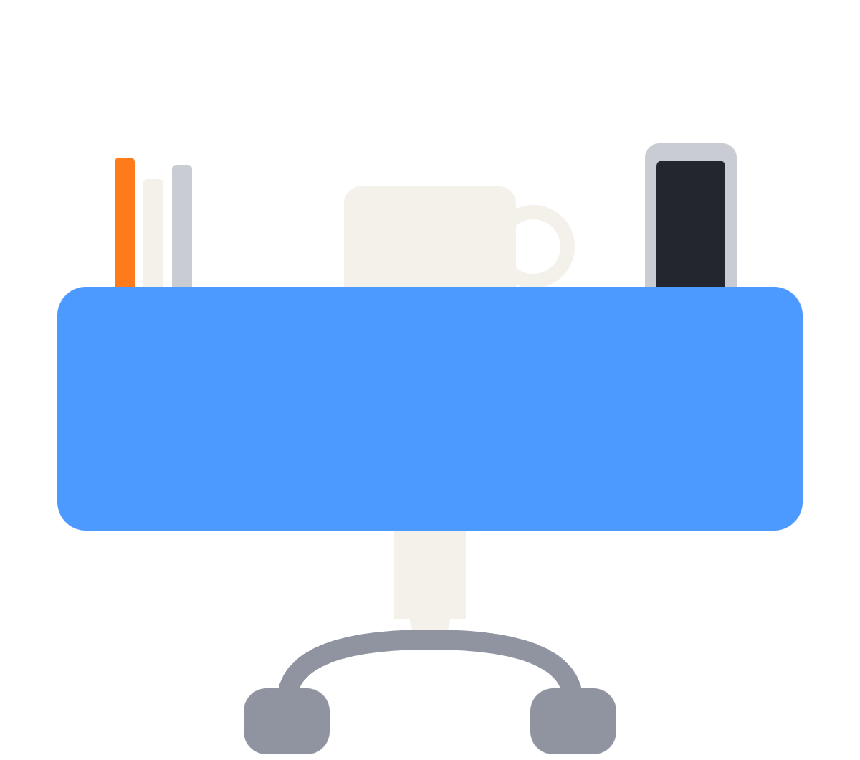
ONE CLAMP, FOUR JOBS
02 · OUR IDEA
01
02
Pens
Mug
Curved pen cup in the corner.
Round pocket with a handle slot.
03
04
Phone
Headset
Upright slot you can see.
Hook under the box, plus cable clips.
Concept sketch · inspired by commercial 4-in-1 desk holders · our own design
3 / 12
Notes:
Explain the product in one breath using the sketch: pens, a mug and a phone sit in the box, and the headphones hang from the hook below. It is inspired by commercial clamp-on organizers, but we will design our own parts so we can fit our desks and print it ourselves.

Slide 4
PLASTIC, SIMPLE SHAPES, NO ELECTRONICS
03 · WHY 3D PRINT IT
3
0
195
1
printed parts
supports needed
mm longest side
size to change
Clamp, caddy box and headphone hook.
Each part is oriented to print without them.
Fits a 220 × 220 mm print bed.
A bad fit means editing one dimension and reprinting.
Dimensions are our design targets, to be checked against the printer we are given
4 / 12
Notes:
This is the feasibility slide. Everything is plastic, the shapes are simple, and a failed print costs little. Confirm the bed size with sir before the final print. The 195 mm figure is our target, not a measured result yet.

Slide 5
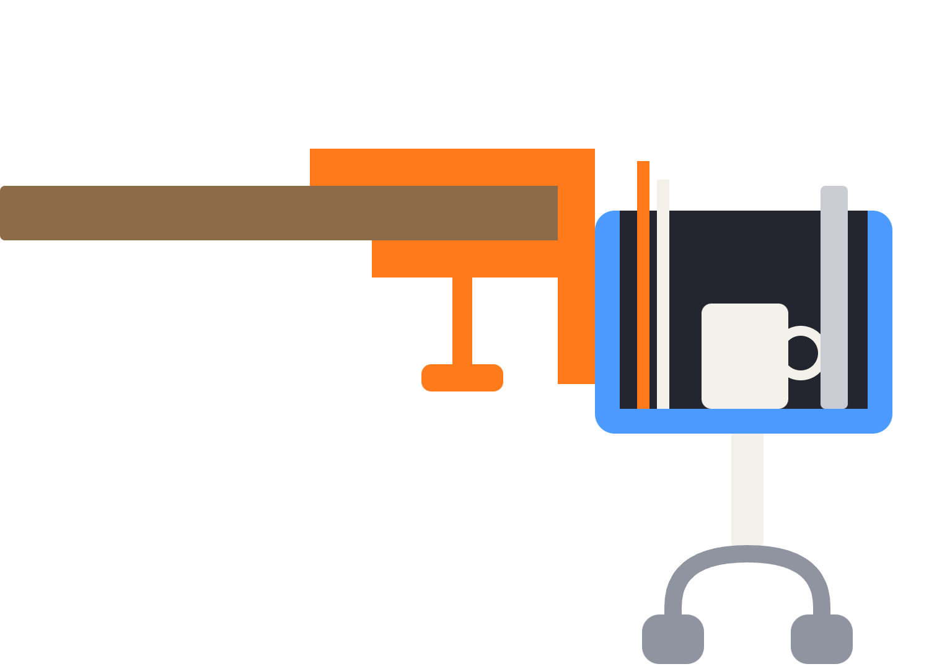
THREE PARTS THAT SLIDE TOGETHER
04 · THE DESIGN
1 · C-clamp and screw
Grips the desk edge. Printed on its side so the plastic strands wrap around the bend.
2 · Caddy box
Pen cup, mug pocket and phone slot. Printed upright for clean, straight walls.
3 · Headphone hook
Slides in below the box. Printed on its side so the curve is strong.
Concept sketch, not to scale · sliding dovetail joints connect the parts
5 / 12
Notes:
Walk the sketch from the desk outward: the orange clamp grips the desk edge, the blue box hangs from it, and the cream hook sits underneath. A one-piece print would be weakest exactly where the load is highest, so splitting it lets us choose the print direction per part. The sketch is a concept, not the final model.

Slide 6

THE CLAMP MUST RESIST 2.2 N·M
05 · THE LOAD
Item | Weight
Full ceramic mug | 650 g
Phone and pens | 300 g
Headphones | 350 g
Safety allowance for bumps | 1500 g
Design load | 2.8 kg
TORQUE ON THE CLAMP
27.5 N × 0.08 m
= 2.2 N·m
The load (orange arrow) sits about 80 mm out from the desk edge (dashed line).
Estimates for design purposes, to be confirmed with a weight test
6 / 12
Notes:
Show the working. 2.8 kg times 9.81 is about 27.5 newtons. The lever arm is about 80 mm, so the torque is 2.2 newton-metres. The sketch shows the load hanging out from the desk edge. The safety allowance of 1.5 kg covers someone bumping the caddy. These are our assumptions, so we will prove them with a real weight test before putting a hot drink on it.

Slide 7
PETG, NOT PLAIN PLA
06 · THE MATERIAL
Why PLA is risky
Why PETG
Softens at roughly 55 to 60 °C
Hot coffee can warp a thin base
Slowly stretches under constant clamp pressure
Handles hotter drinks than PLA
Flexes slightly before it snaps
Resists the clamp slowly going loose
ABS or ASA also work. If only PLA is available, add a cork coaster in the mug pocket.
Temperatures are typical values and vary by filament brand
7 / 12
Notes:
Material choice matters because the clamp is under constant stress and a mug may be hot. PETG is our first choice. Dry the filament before printing, because wet PETG strings and bonds worse between layers.

Slide 8
TARGET SIZES FOR THE MODEL
07 · CAD DIMENSIONS
Feature | Target | Reason
Caddy box (L × W × H) | 195 × 105 × 90 mm | Fits a 220 × 220 mm bed
Walls and floor | 3.6 mm and 4 mm | Stiff, many solid lines per wall
Mug pocket | 92 mm inner diameter | Fits mugs of 80 to 88 mm
Mug handle slot | 22 × 65 mm | Rounded entry so the handle slides in
Clamp opening | 55 mm, 12 mm spine | Fits desks 12 to 48 mm thick
Clamp inner corners | 6 mm fillet | Avoids a crack-starting sharp corner
Screw thread | 16 mm, offset 0.25 to 0.30 mm | Turns without binding
Dovetail joints | 60° angle, 0.25 mm gap | Parts lock together by gravity
Starting values, to be tuned after the first test print
8 / 12
Notes:
Do not read the whole table. Pick three: the box fits the bed, the mug pocket fits normal mugs, and the clamp opening covers common desk thicknesses. Say these are starting values that we will adjust after the first test print. Measure our own desk edge before finalising the clamp.

Slide 9
STRONG PARTS, FAST BOX
08 · SLICER SETTINGS
Setting | Clamp, screw and hook | Caddy box
Orientation | Flat on its side (screw upright) | Upright, base on the bed
Layer height | 0.16 to 0.20 mm | 0.20 to 0.24 mm
Wall loops | 5 to 6 | 3 to 4
Infill | 40 to 50% | 15 to 20%
Infill pattern | Gyroid or cubic | Gyroid or grid
Supports | None | None
More wall loops add more bending strength than more infill, because stress is highest at the outer skin.
Settings for PETG on a 0.4 mm nozzle
9 / 12
Notes:
The clamp and hook carry the load, so they get thick walls and more infill. The box is mainly a container, so we save time and filament there. Cooling fan at 20 to 40 percent on the clamp helps the layers fuse. A brim helps the tall screw stay on the bed.

Slide 10
FROM DESK TO FINISHED PRINT
09 · PLAN
1
2
3
4
5
Measure
Model
Test print
Final print
Assemble
Desk edge, mug, phone, headphones.
Three parts in CAD.
Small clamp section to check fit.
All three parts in PETG.
Rubber pads, then a 2 kg test.
Timeline: [dates to be agreed with sir]
Desk Caddy · PDR pitch
10 / 12
Notes:
Walk through the five steps. Emphasise the small test print before the big one, so a mistake costs a few grams of filament. Fill in the real dates after agreeing them with sir. The anti-slip pads on the clamp stop it sliding on a smooth desk.

Slide 11
WHAT COULD GO WRONG, AND OUR FIX
10 · RISKS
Risk | Mitigation
Clamp snaps at a layer line | Print on its side, 5 to 6 walls, 6 mm corner fillets
Clamp slips on a smooth desk | 2 mm rubber or foam pad on both contact faces
Box too big for the printer | Check the bed first, or split the box in two pieces
Screw binds in the clamp | 0.25 to 0.30 mm thread offset, a little wax
PETG strings or weak layers | Dry the filament before printing
Hot mug damages the base | Use PETG, never plain PLA
We test with a 2 kg weight before any hot drink goes in
11 / 12
Notes:
Showing the risks makes the pitch stronger. Every risk has a specific fix we already know. The key safety step is the 2 kg weight test before any hot drink is placed in it.

Slide 12
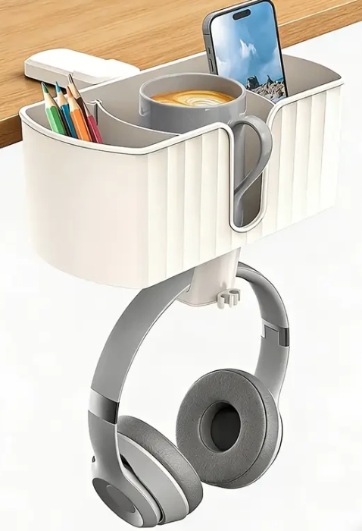
Thank you .... Questions?
11 · OUR ASK
Feedback on the three-part design before we model it.
12 / 12
Notes:
Close with a clear request: printer time, filament, and feedback on the design. Then invite questions. Be ready to answer: why three parts, why PETG, and how we will test the strength.

